Slide 1
ST1504
Deep Learning CA1
Jeyakumar Sriram
2214618
DAAA/FT/2B/01

Slide 2
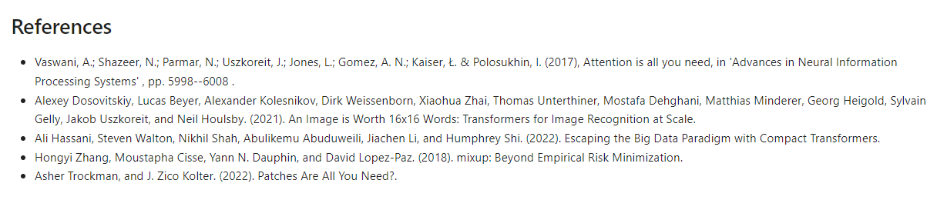
CNN - References
I used the following research papers as reference when doing this part of the assignment

Slide 3
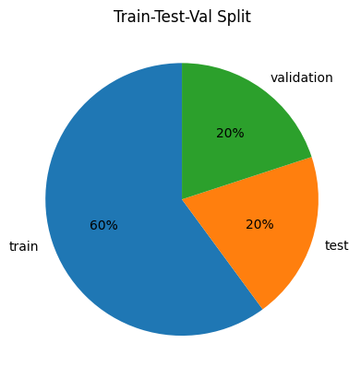
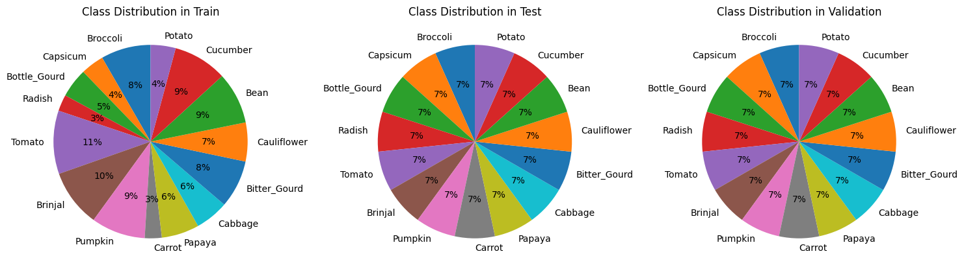
CNN - EDA
I will stick to the default train test split as it looks pretty normal.
Meanwhile the distribution of the classes in test and val looks fine but train is abit imbalance. I will perform augmentation to fix this.

Slide 4
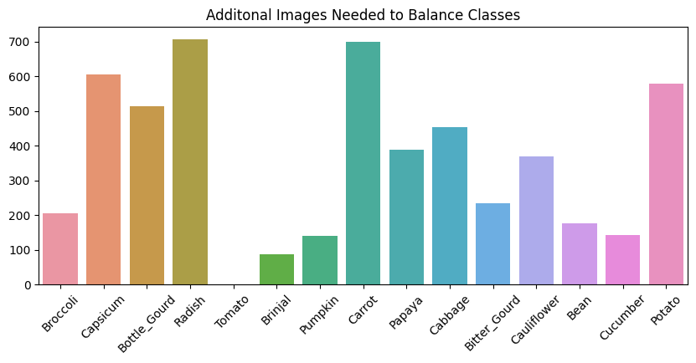
CNN - EDA
In order to balance the classes I will need to generate this many images for each class. I obtained these numbers by taking the maximum and minusing off the rest.

Slide 5
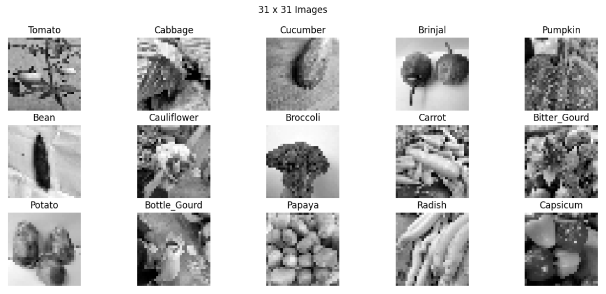
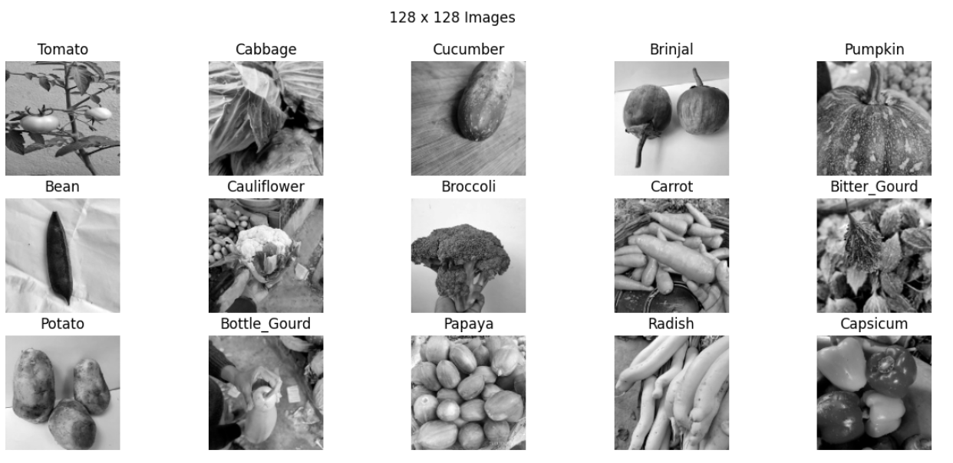
CNN - EDA
Grayscale will make things harder but I am more concerned with the 31 x 31 images as even I can barely tell the difference. We will need to make a very good model to predict this.

Slide 6
CNN - Preprocessing
I did the following for preprocessing:
Applied grayscale for images
Rescaled images by dividing by 255
One hot encoding labels
To make up the class imbalance I augmented the dataset selectively. So for a certain class I augmented just 100 and another just 150 and some 0. After applying simple augmentation like:
random flip
rot90
random brightness
random contrast
I concatenated the two datasets to make one which has perfectly balanced classes

Slide 7
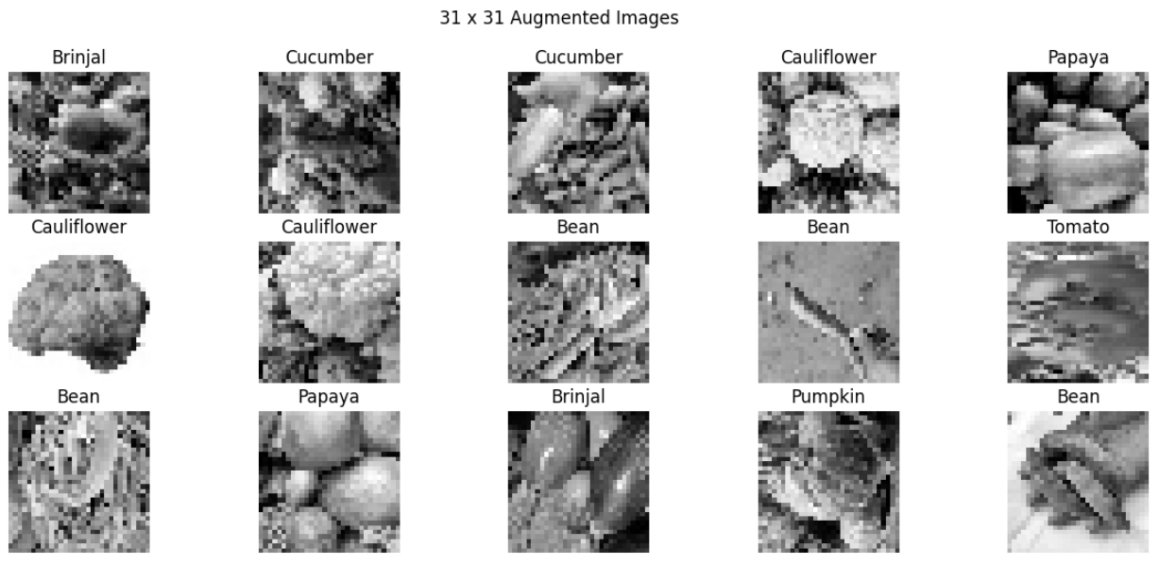
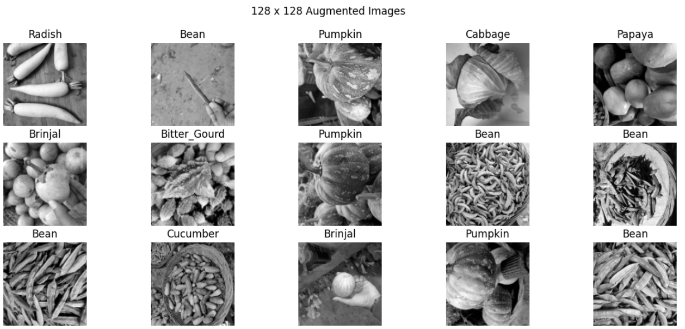
CNN - Preprocessing
These are the augmented images that were added to train. As you can see they are not so different in terms of noise. I wasn’t trying to add too much noise as I have another method to do so.

Slide 8
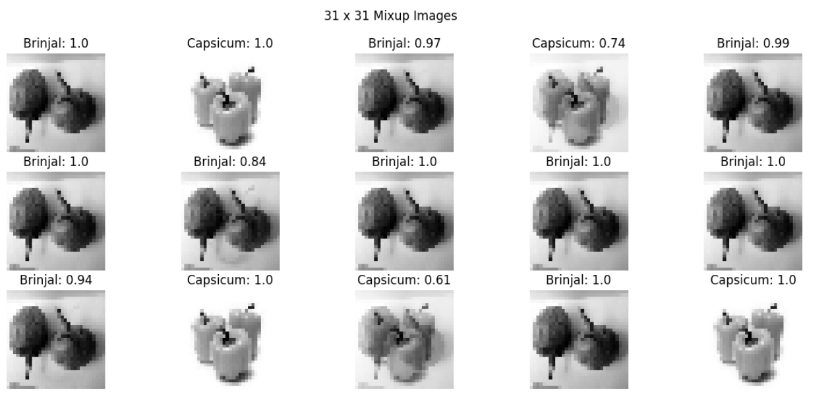
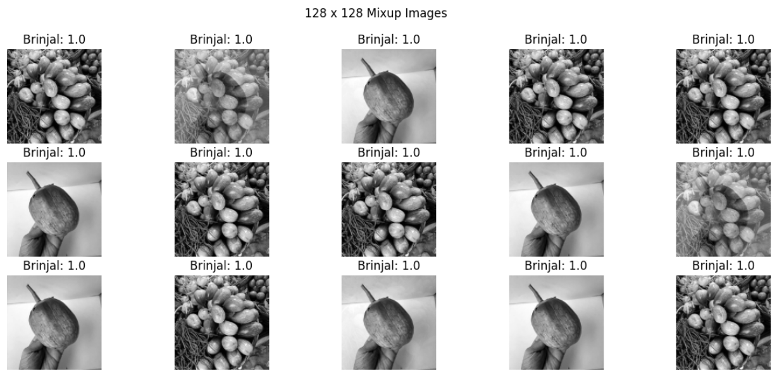
CNN - Preprocessing
To create a more noisy dataset to address overfitting I used MixUp.
MixUp basically mixes two images together in a fixed ratio. The ratio is taken from a beta distribution. I did so as to get values closer to 0 and 1.
In the images beside you can see how they are blended into each other. Along with the images, the labels are also blended so you can see floats in a one hot array cuz the image is a certain proportion of a class.

Slide 9
Disclaimer
All my models are saved as .keras files instead of .h5 files as I extensively used Keras subclassing and its difficult to store such models inside .h5 files.

Slide 10
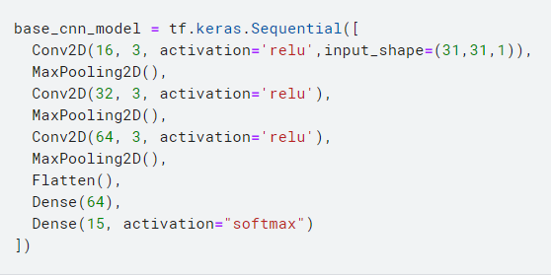
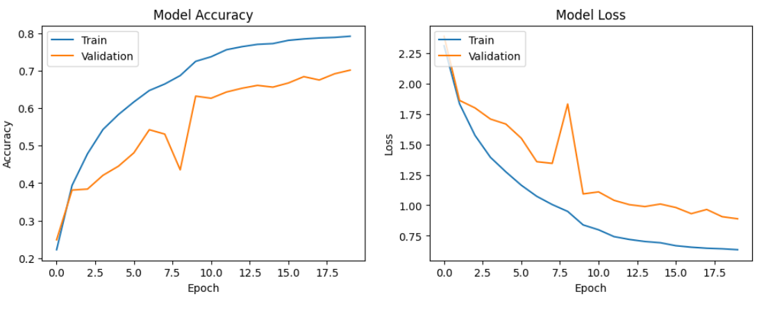
CNN - Models (31 x 31)
I used a simple convolution model as my base model and as you can see it performed decently but plateaued around 0.8 accuracy.

Slide 11
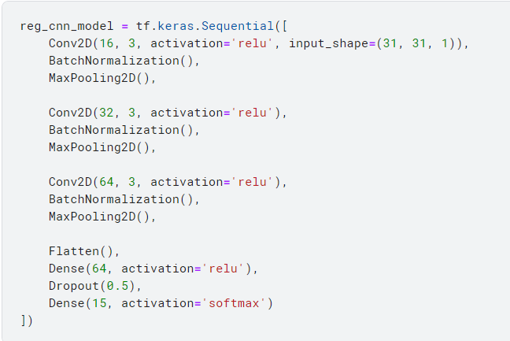
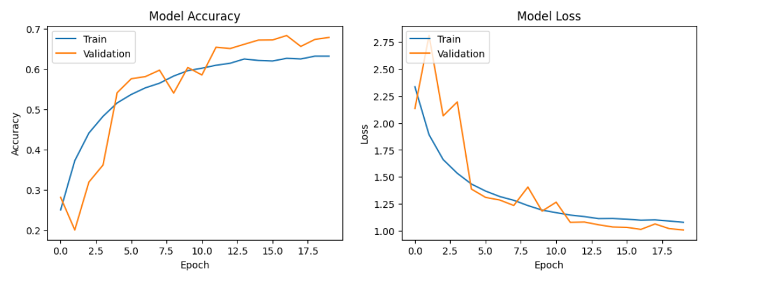
CNN - Models - (31 x 31)
To break the plateau I decided to add more dropout and also add normalisation.
But they performed worse.
So I decided to pull out the big
guns. TRANSFORMERS!!

Slide 12
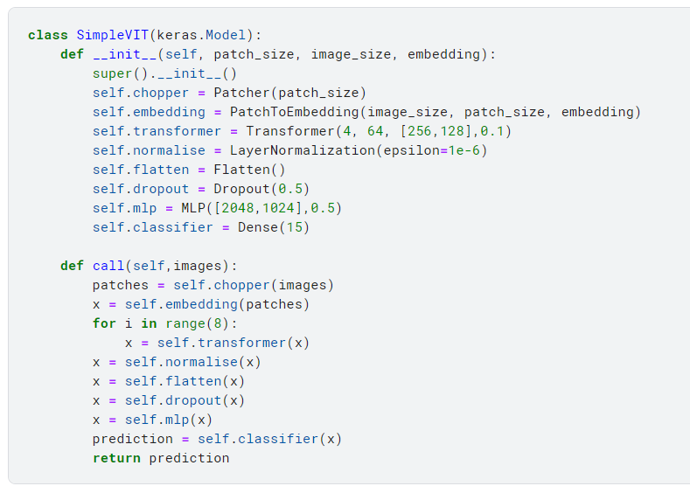
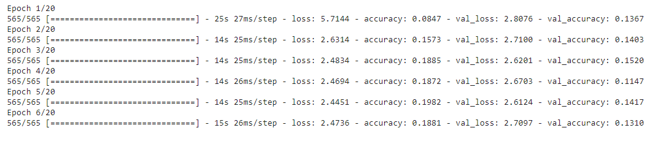
CNN - Models - (31 x 31)
First, I started out with a vanilla Vision Transformer as described in the research paper.
It basically takes a images, cuts it into 6x6 patches, encodes those patches and sends them into a transformer
But the model performed very badly. I am pretty sure it is because the image data patching wasn’t as efficient at extracting useful information as convolution was.

Slide 13
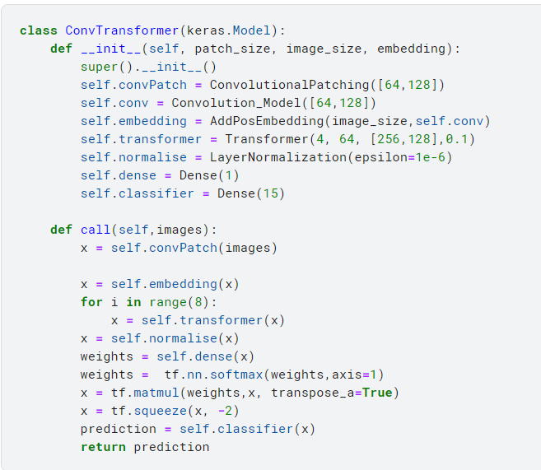
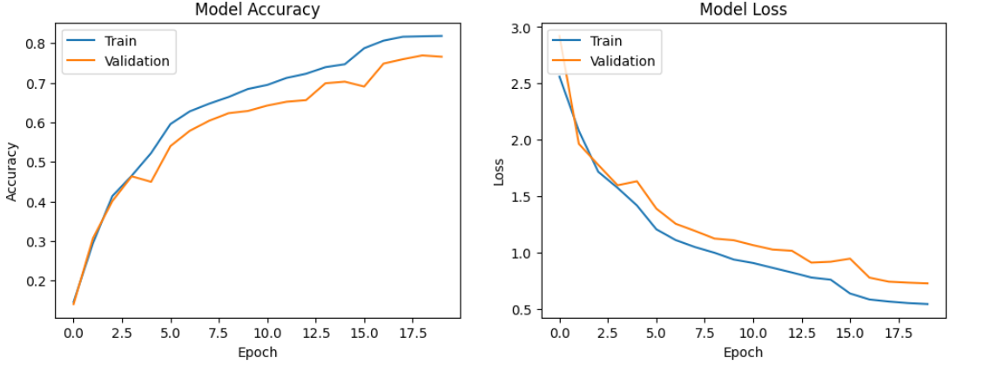
CNN - Models - (31 x 31)
So I decided to bring convolution to transformers and began searching. Eventually I found a research paper on Compact Convolutional Transformers which, instead of chopping up images to make patches, use convolution to create small patches and encode them.
And it outperformed every model I had made. So I decided to keep this model for my 31 x 31 model

Slide 14
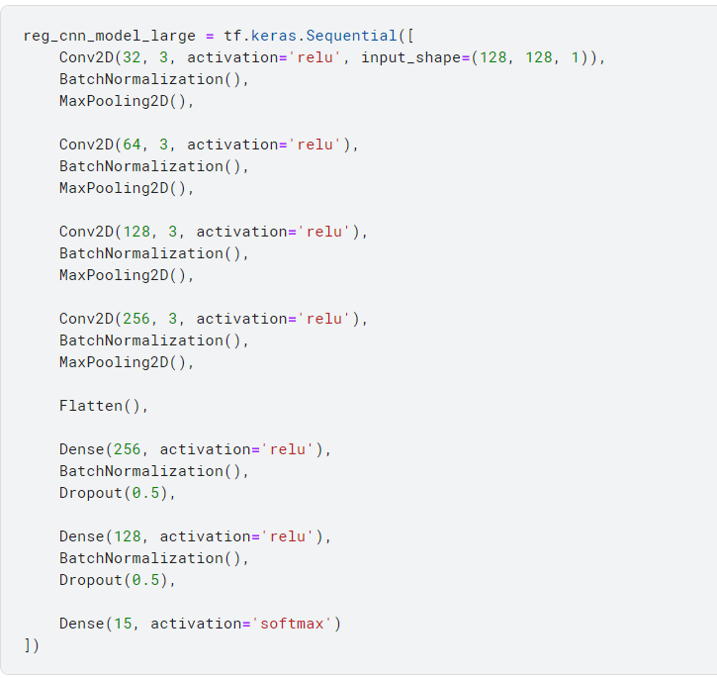
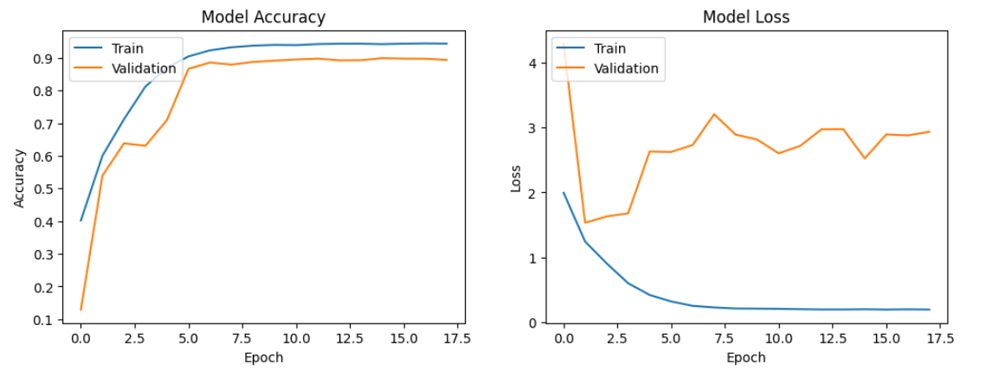
CNN - Models - (128 x 128)
Since this image has more resolution, I was confident to use a more deeper convoutional model to serve as my base model.
After running it, the model was better than 31 x 31 but it shows signs of plateau around 0.9 for validation accuracy.

Slide 15
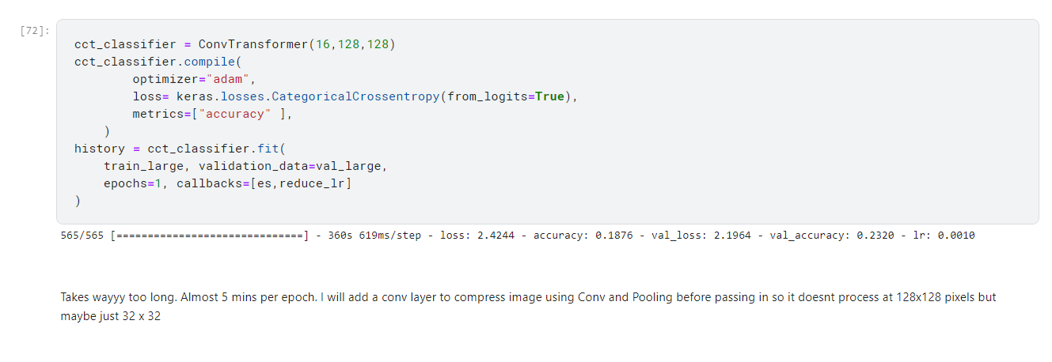
CNN - Models - (128 x 128)
After seeing how insane Convolutional Transformers were for my 31 x 31 model I decided to use them for 128 x 128 model thinking they will be better on more data.
But I faced a new problem…Complexity! Since the images were bigger so was everything else. And the transformer took 5 MINS for one epoch.

Slide 16
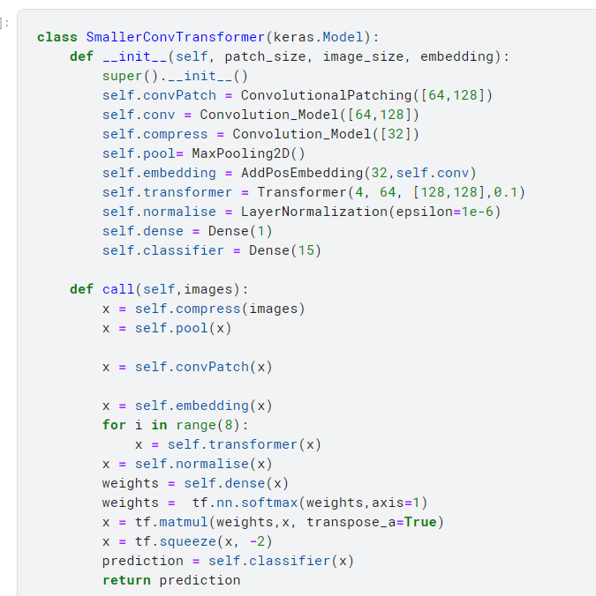
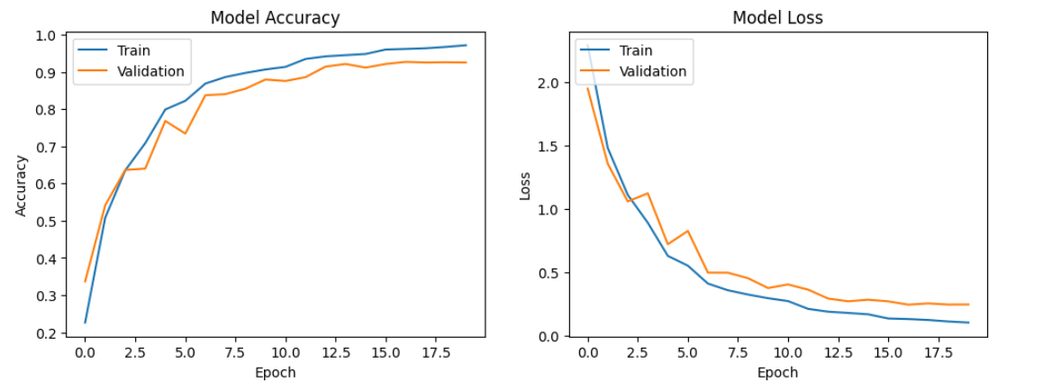
CNN - Models - (128 x 128)
As I was thinking of ways to reduce model complexity, I decided to use convolution and pooling to reduce the image to a 32 x 32 vector before passing it into the model and I implemented it
And the accuracy was INSANE. It was reaching 0.9 validation accuracy within 10 epoch and plateau much slower than the convolutional
models.
There is clearly more potential here

Slide 17
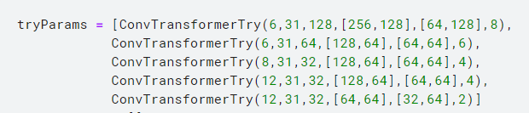
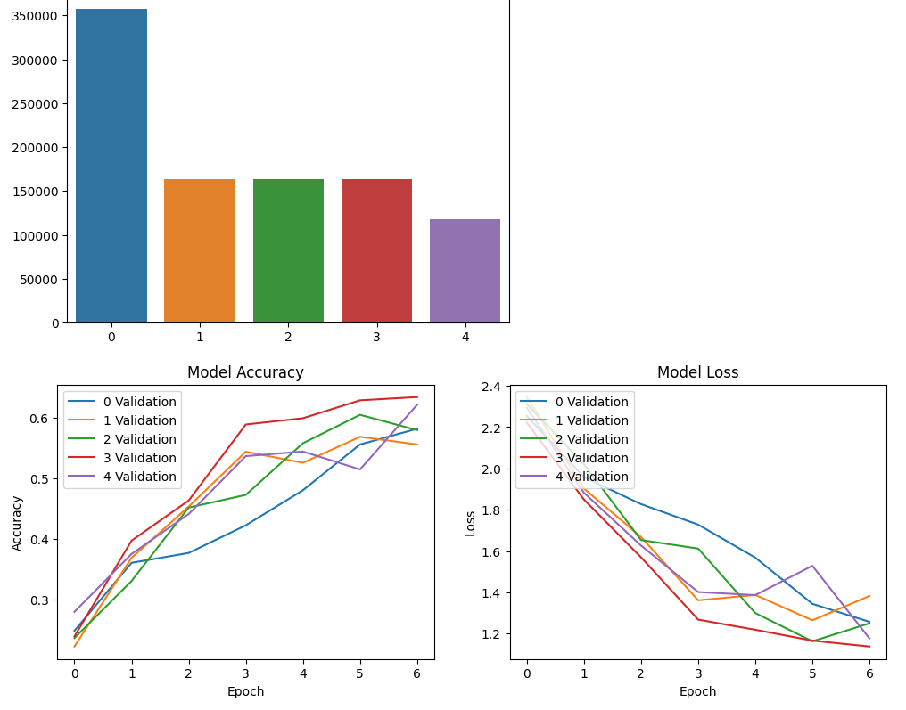
CNN - Reduce Model Complexity
I compared 5 models with reducing complexity on my 31 x 31 dataset and plotted their validation accuracy.
Surprisingly the model with the lowest complexity outperformed others by not plateauing so fast.
I decided to choose this config for my final model

Slide 18
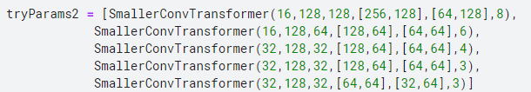
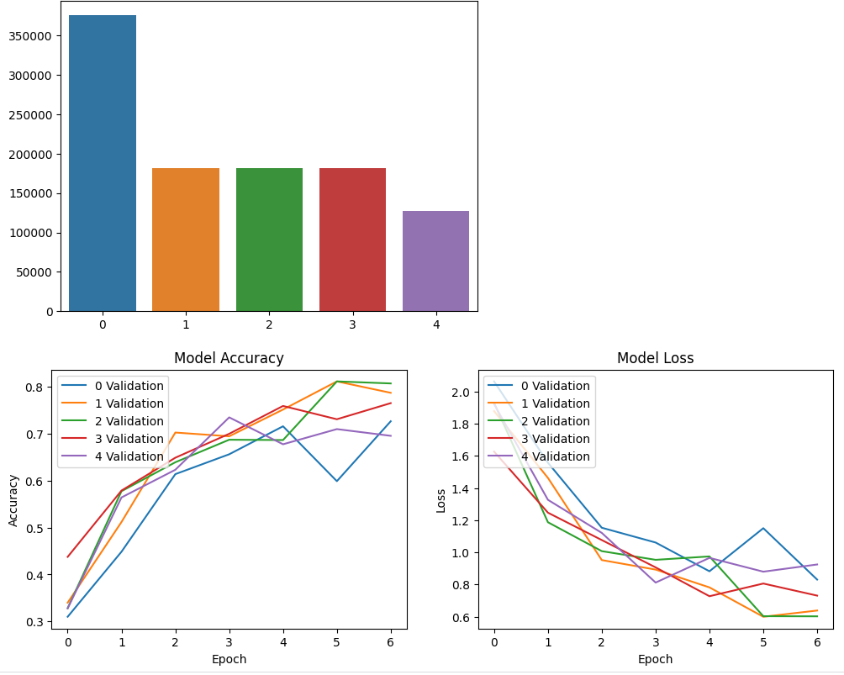
CNN - Reduce Model Complexity
I also did the same for my 128 x 128 model and managed to reduce the complexity after finding that the 4th model had the strongest performance of the 5.
I chose that for my final training

Slide 19
CNN - Final Training
For my final training, I will do certain things differently:
Increase epochs to 30 to allow more comprehensive training
Reduce learning rate on plateau to keep the learn until the last epoch
Progressively fitting noisier data. So I will start with the normal data and once the model overfits, the EarlyStopping will activate and it will refit with the augmented data from mixup. This will basically help model overcome the plateau

Slide 20
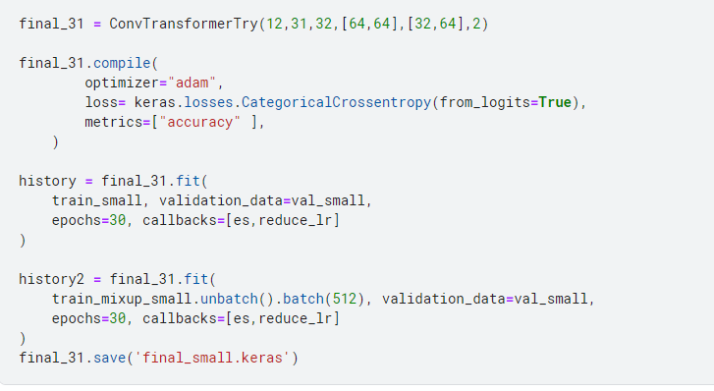
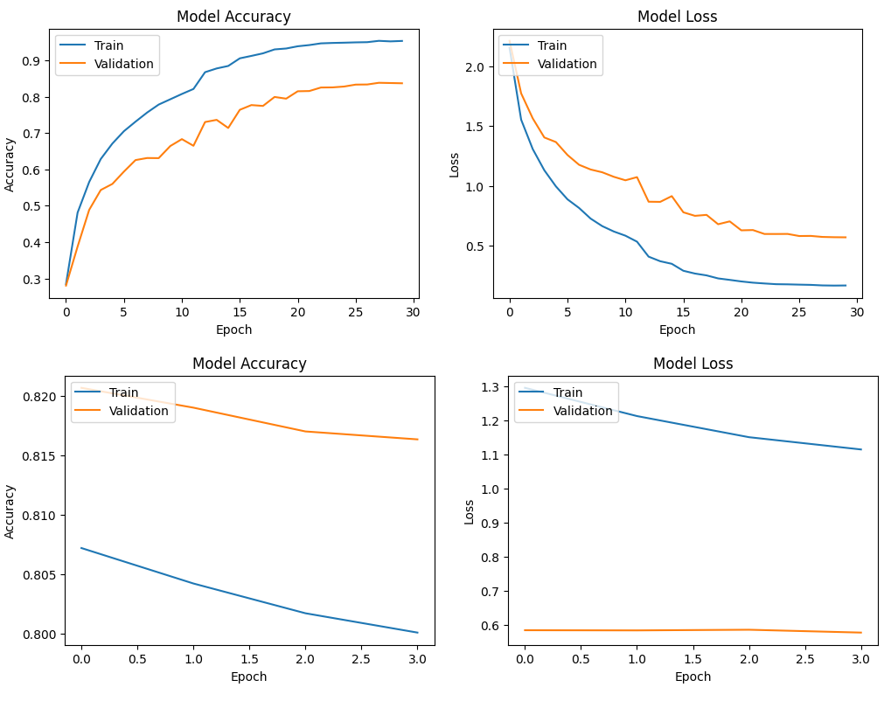
CNN - Final Model - 31 x 31
After the final fitting, the model has a 82.3% validation accuracy which is pretty good for the quality of data
Mixup didn’t really help much here but the val_loss slightly decreased

Slide 21
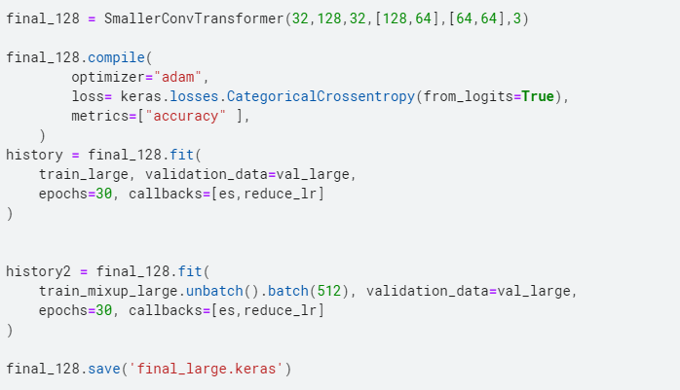
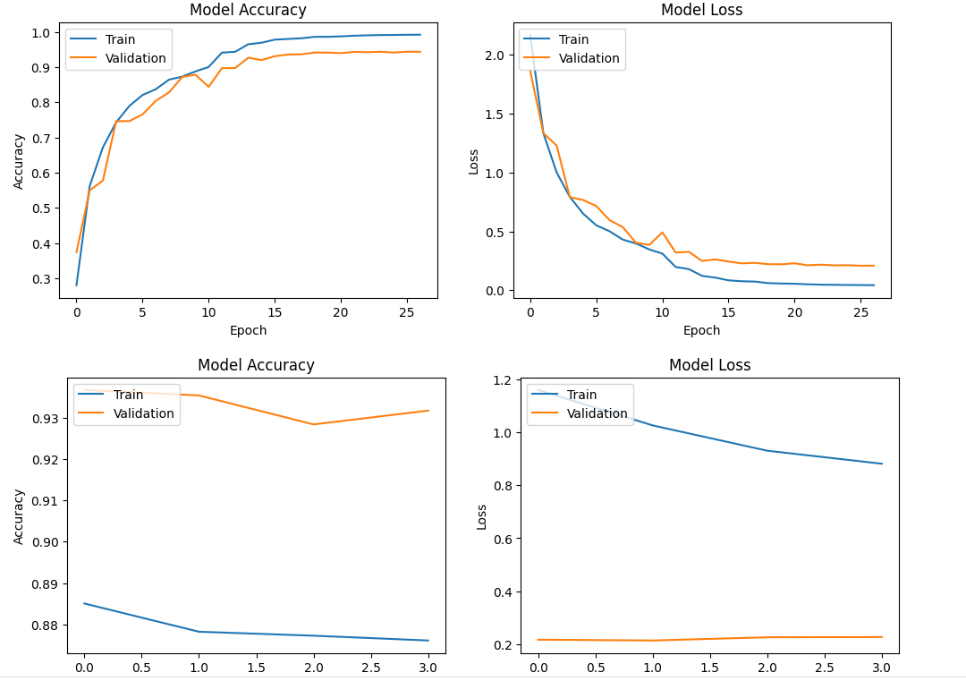
CNN - Final Model - 128 x 128
Models performs amazingly with validation accuracy reaching 93%. After using the mixup, nothing much happened but the accuracy was maintained.

Slide 22
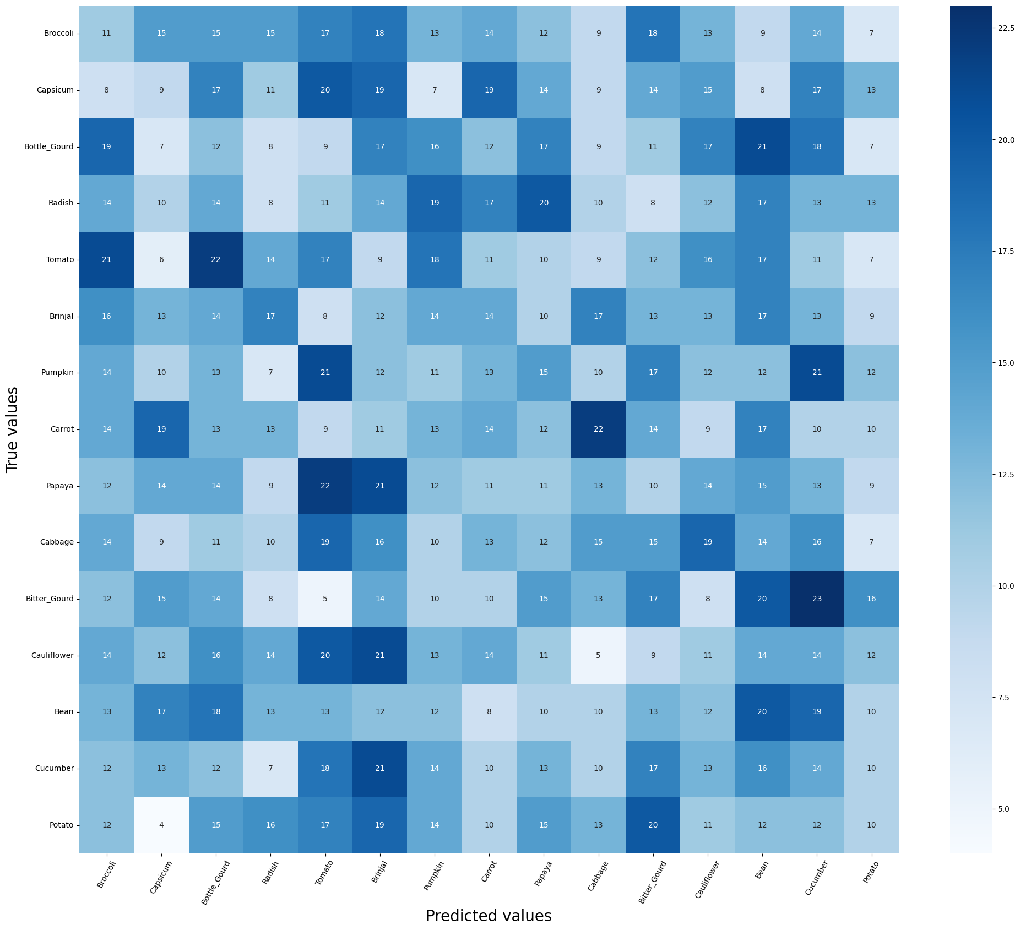
CNN - Evaluation (31 x 31)
Test Accuracy: 81.8%
Test Loss: 0.57
Overall model did well. Looking at the confusion matrix, most of the errors were from similar looking vegetables like cucumbers and potatoes, potatoes and bottle_gourd. So the accuracy is reasonable due to the fact that even a human might not be able to distinguish them at this resolution

Slide 23
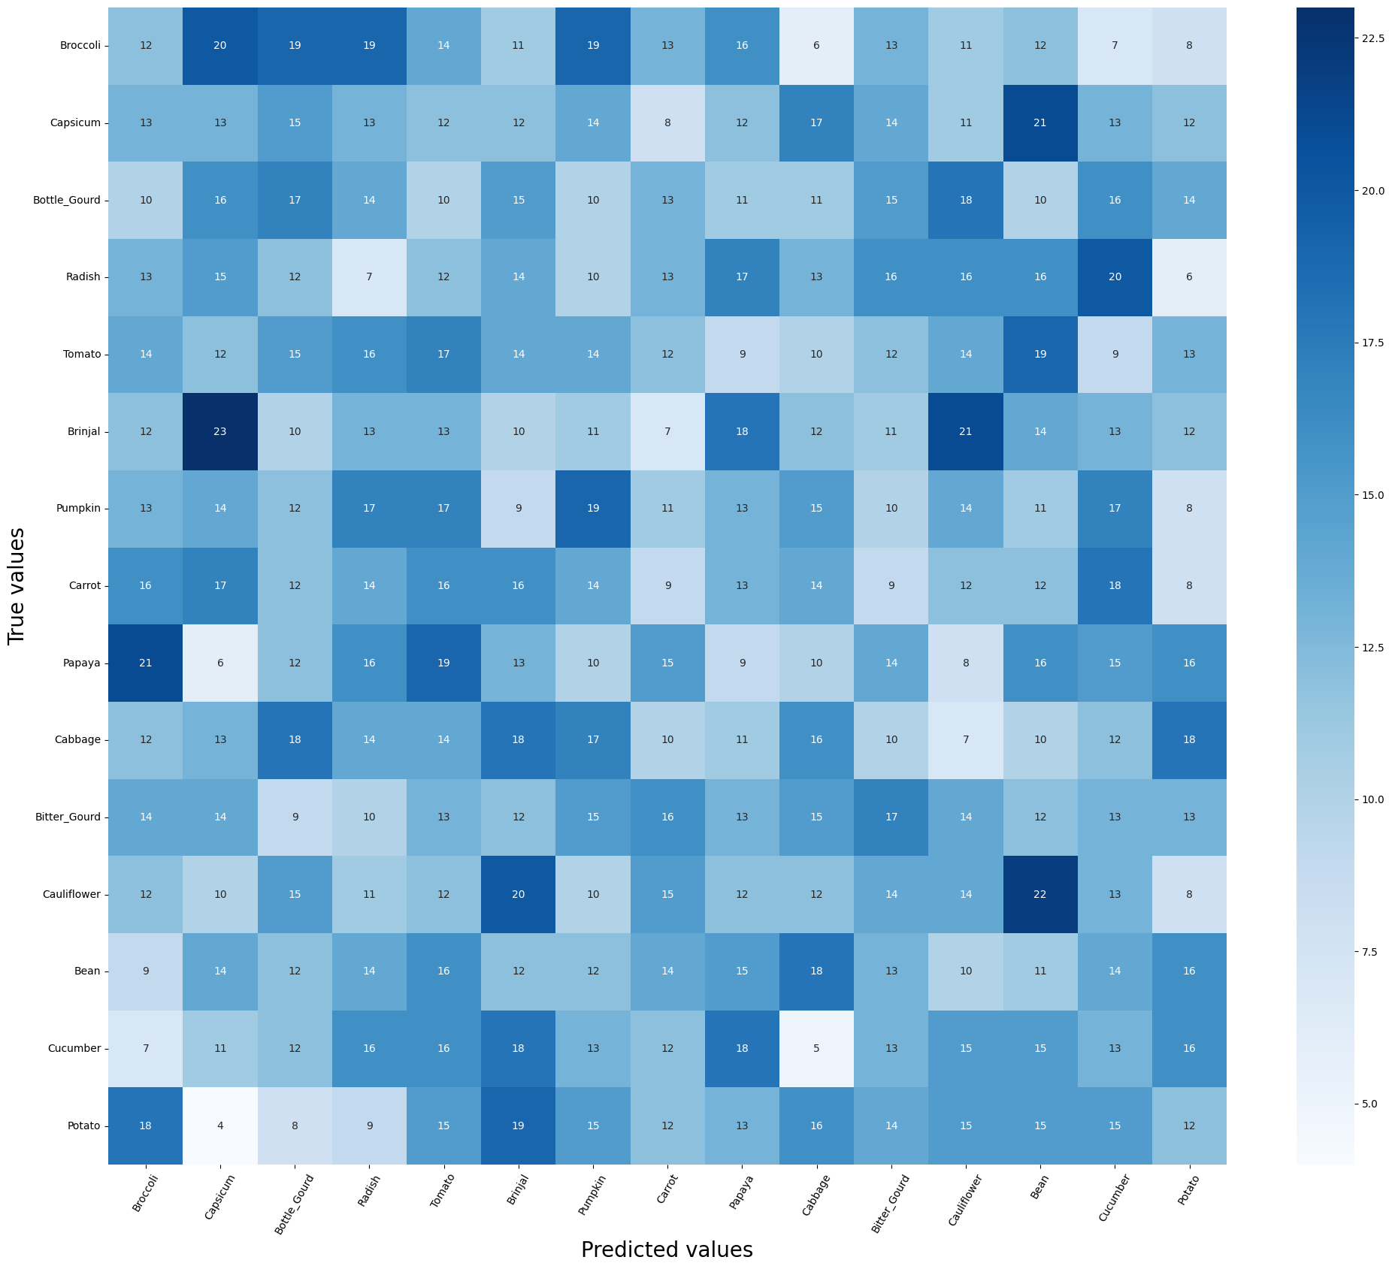
CNN - Evaluation (128 x 128)
Test Accuracy: 92.8%
Loss: 0.23
This model definitely performed better due to higher resolution. Again looking at the confusion matrix the errors are from similar looking vegetables. I would fault the model for that.

